Slide 1
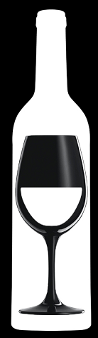

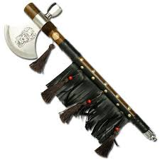
November 2017 Reviews
What wines offer the best overall value based on their rating vs. their price?
“Bang For Buck Score”: Rating - Price
Data Source:
https://www.kaggle.com/zynicide/wine-reviews
129,970 Wines Reviewed
TOMAHAWKS

Slide 2
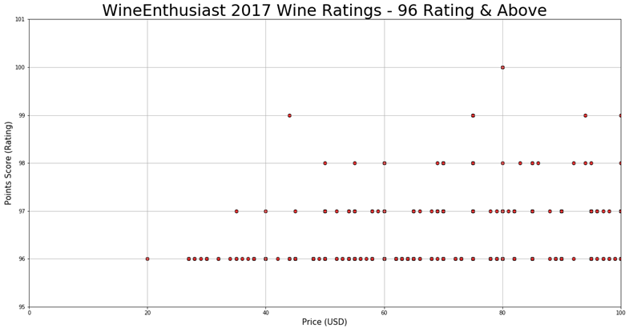
November 2017 Reviews
Data Source:
https://www.kaggle.com/zynicide/wine-reviews
129,970 Wines Reviewed
TOMAHAWKS

Slide 3
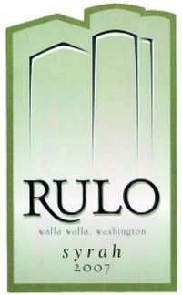
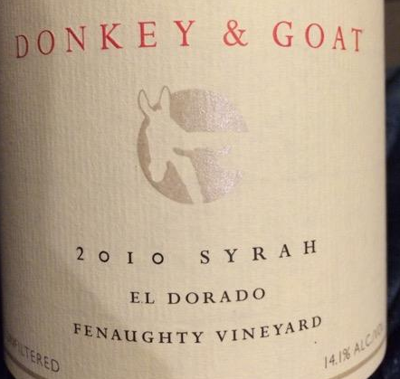

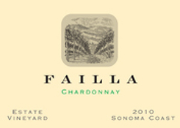
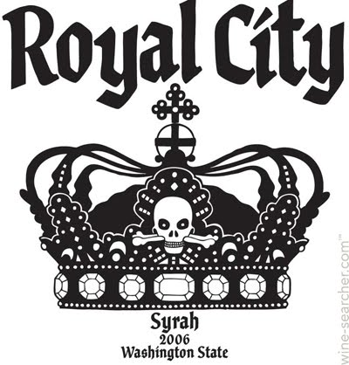
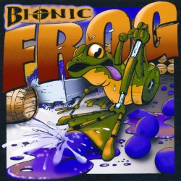
November 2017 Reviews
96 Rating: Rulo 2007 Syrah (Columbia Valley (WA)) - $20.00
97 Rating: Donkey & Goat 2010 Fenaughty Vineyard Syrah (El Dorado) - $35.00
98 Rating: Pirouette 2008 Red Wine Red (Columbia Valley (WA)) - $50.00
99 Rating: Failla 2010 Estate Vineyard Chardonnay (Sonoma Coast) - $44.00
100 Rating (Tie): Charles Smith 2006 Royal City Syrah (Columbia Valley (WA)) & Cayuse 2008 Bionic Frog Syrah (Walla Walla Valley (WA)) - $80.00
Data Source:
https://www.kaggle.com/zynicide/wine-reviews
129,970 Wines Reviewed
TOMAHAWKS

Slide 4
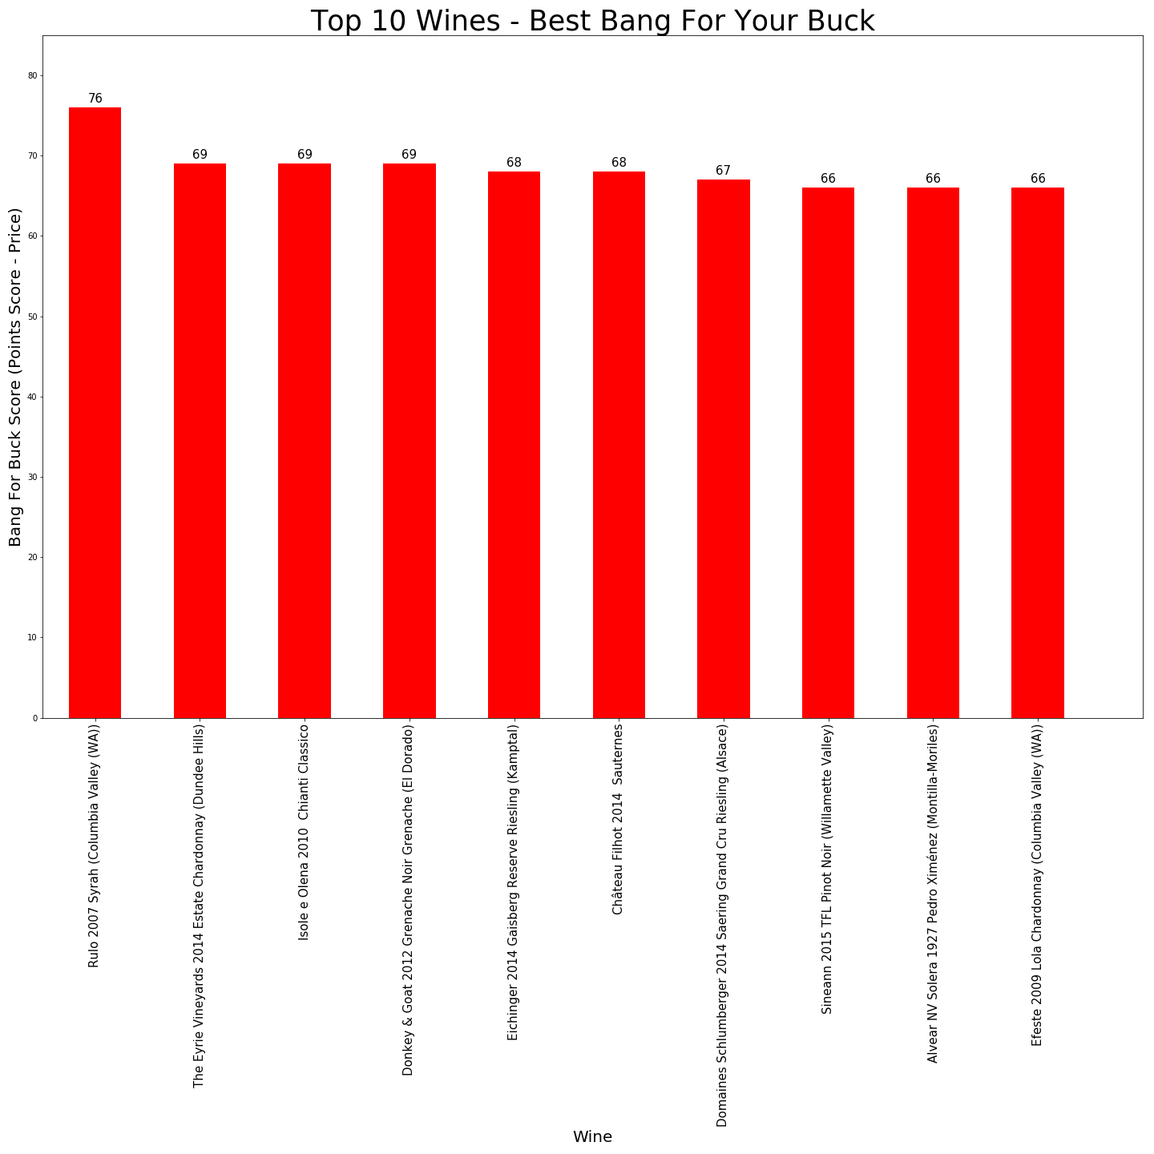
November 2017 Reviews
Data Source:
https://www.kaggle.com/zynicide/wine-reviews
129,970 Wines Reviewed
TOMAHAWKS

Slide 5
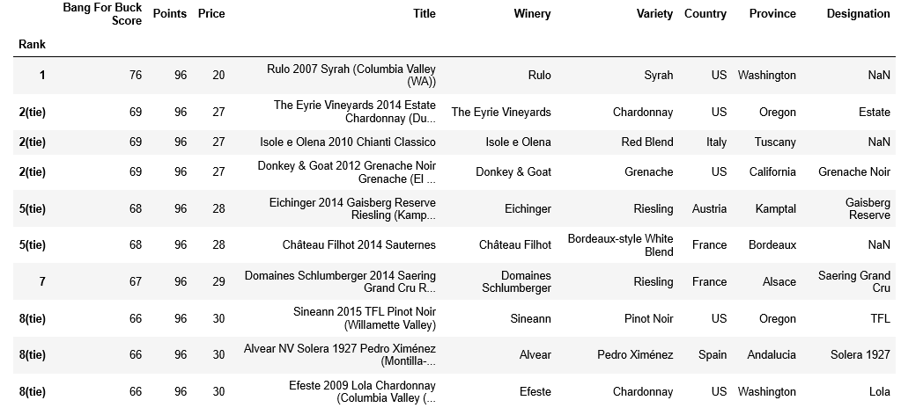
November 2017 Reviews
Data Source:
https://www.kaggle.com/zynicide/wine-reviews
129,970 Wines Reviewed
TOMAHAWKS

